Slide 1
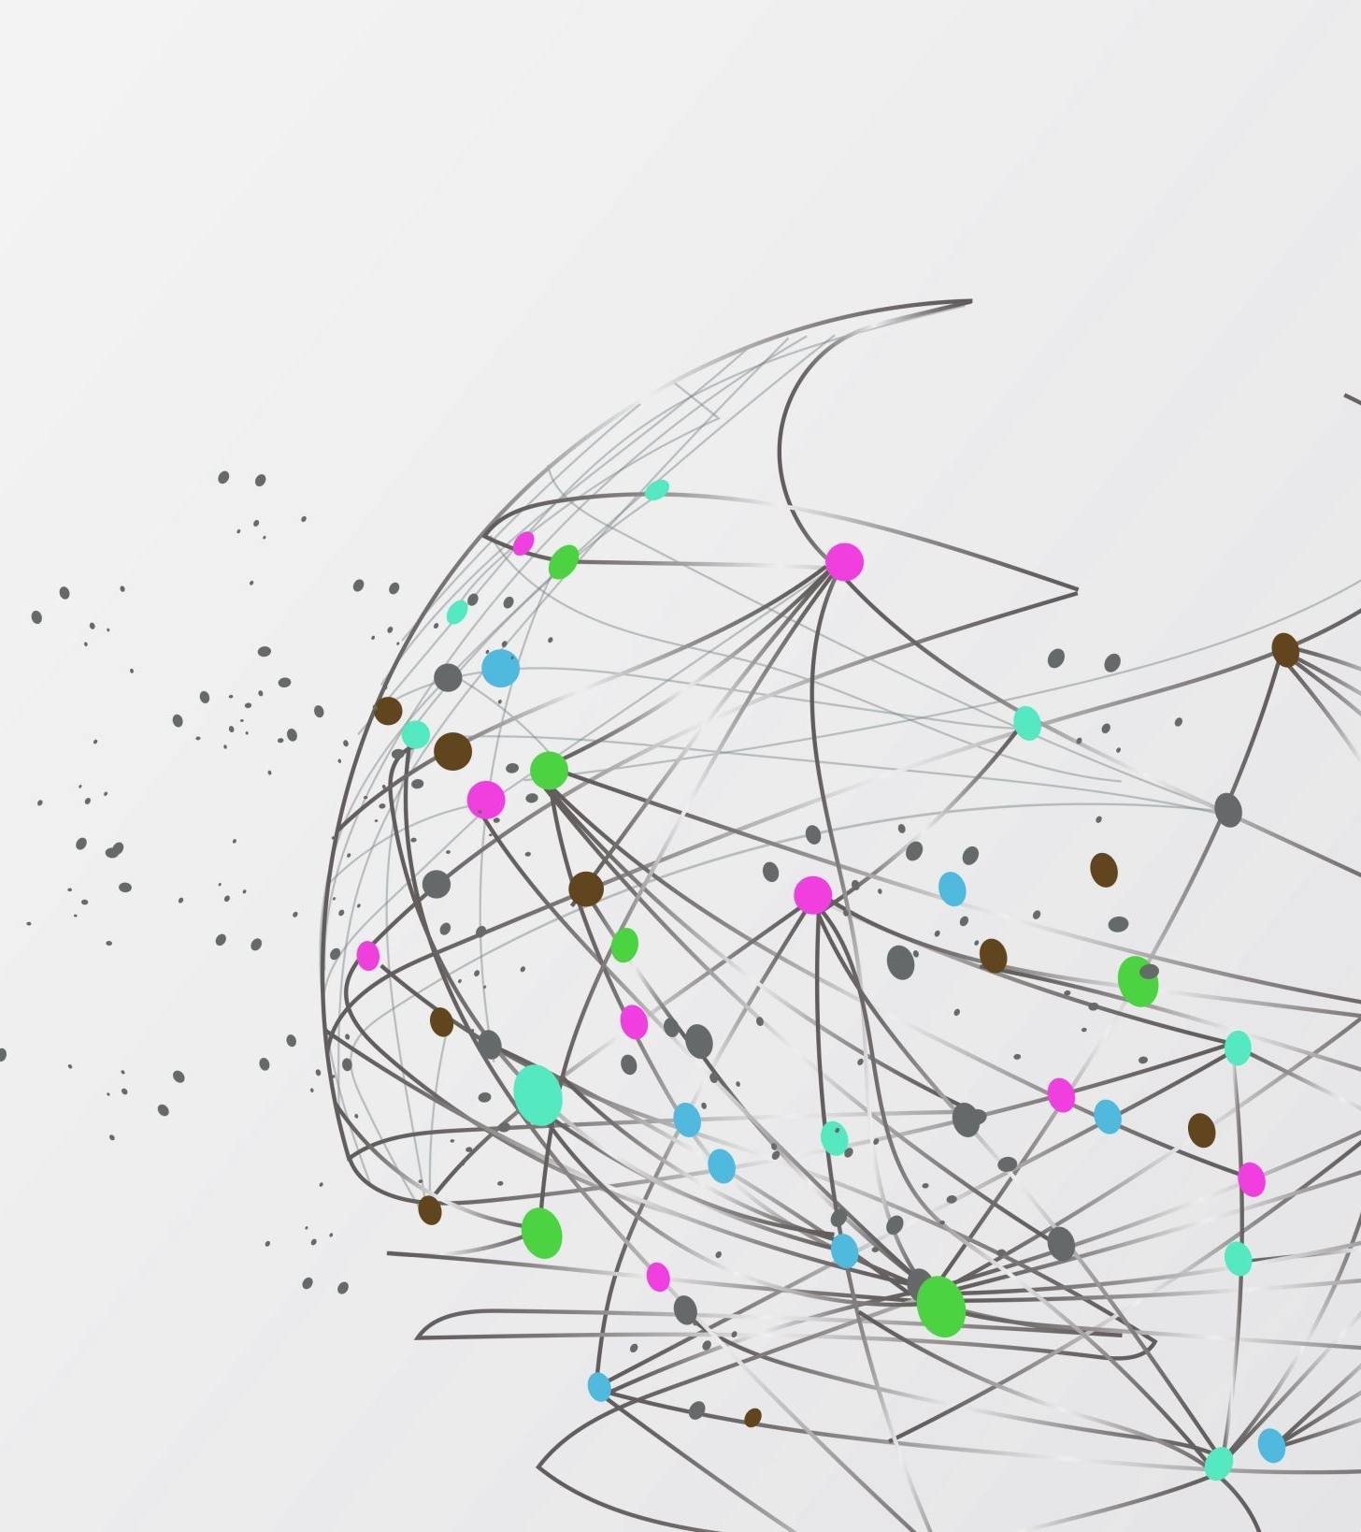
ODURU LASYA 211521104100
FINAL PROJECT

Slide 2

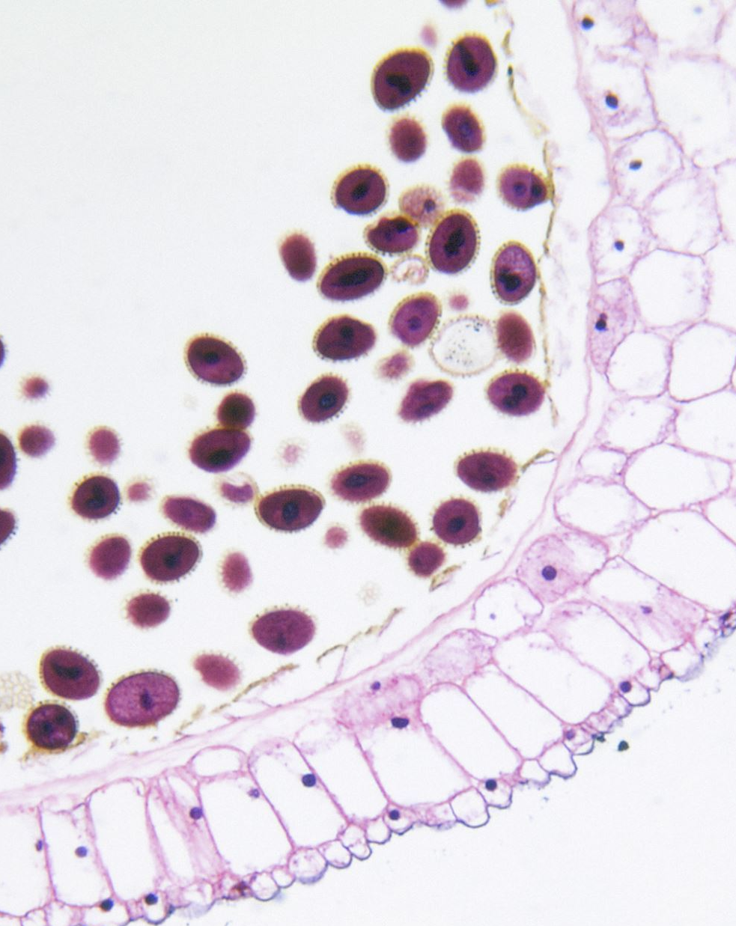
TITLE:PLANT DISEASE DETECTION

Slide 3
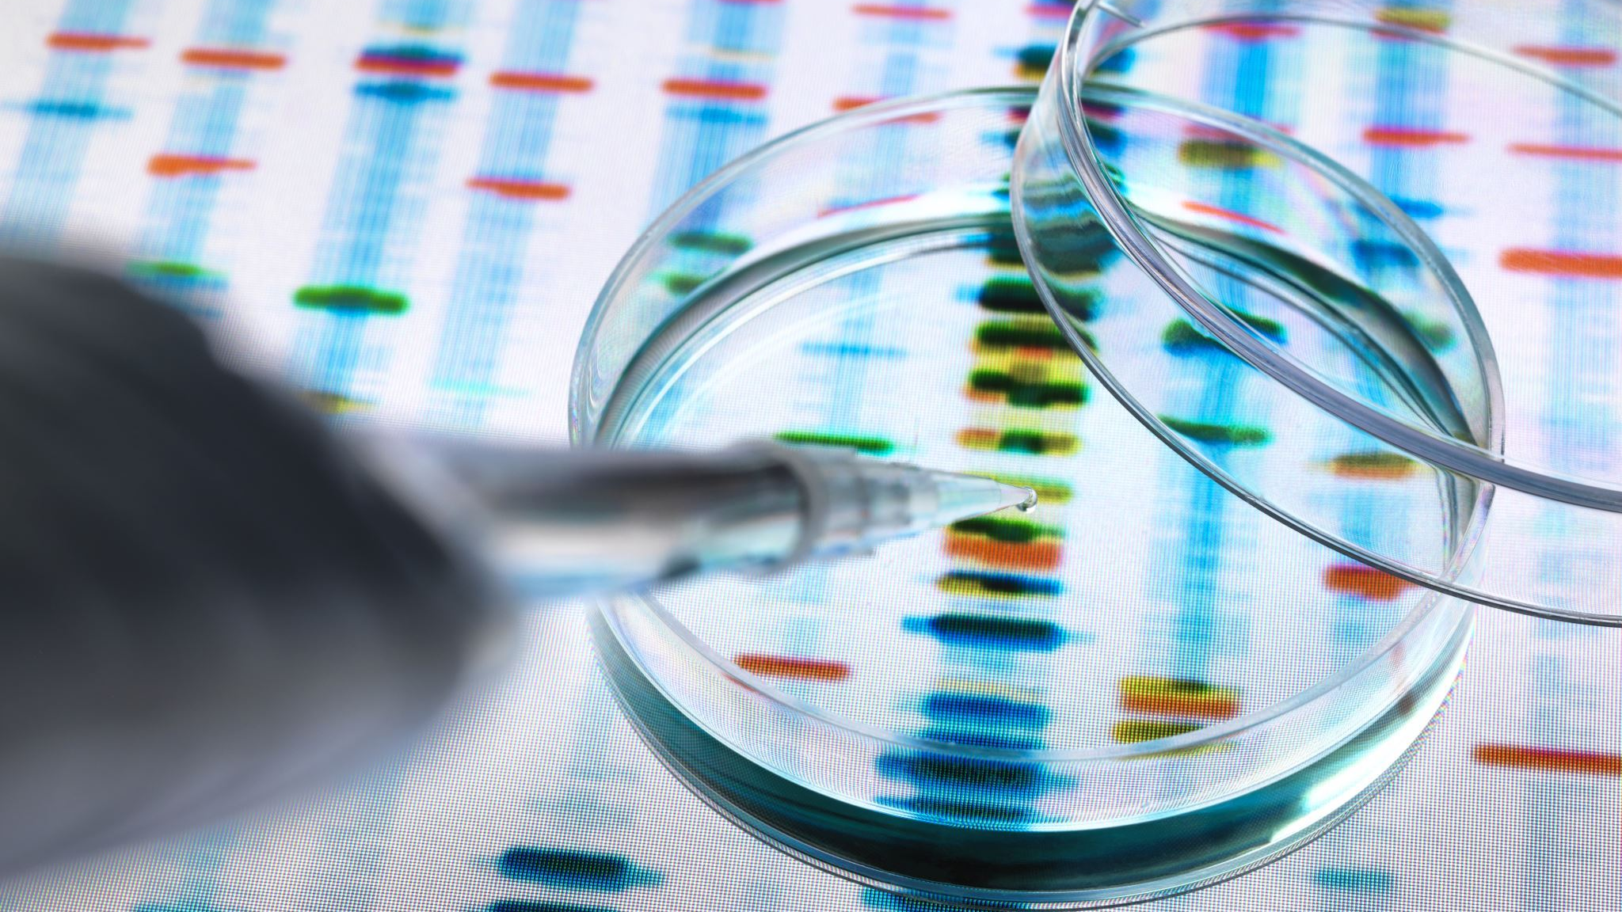
AGENDA
Introduction
Importance of Disease Detection
Types of Plant Diseases
Traditional Methods of Disease Detection
Modern Techniques
Challenges and Limitations
Future Direction
Case Studies
Conclusion

Slide 4
PROBLEM STATEMENT
Effective and timely detection of plant diseases is crucial for sustainable agriculture and food security. However, existing methods often rely on manual observation, which can be time-consuming, subjective, and prone to errors. Additionally, with the increasing complexity and diversity of plant diseases, there is a growing need for more accurate and efficient detection techniques.
The challenge lies in developing innovative and automated solutions that can accurately identify plant diseases at an early stage, differentiate between various pathogens, and provide actionable insights for farmers to take preventive measures. Furthermore, these solutions should be cost-effective, user-friendly, and accessible to farmers across different regions and socioeconomic backgrounds.
Addressing these challenges requires interdisciplinary research combining expertise in plant pathology, sensor technology, artificial intelligence, and data analytics. By developing advanced disease detection systems, we can enhance crop productivity, reduce yield losses, minimize the use of pesticides, and contribute to sustainable agricultural practices globally.

Slide 5
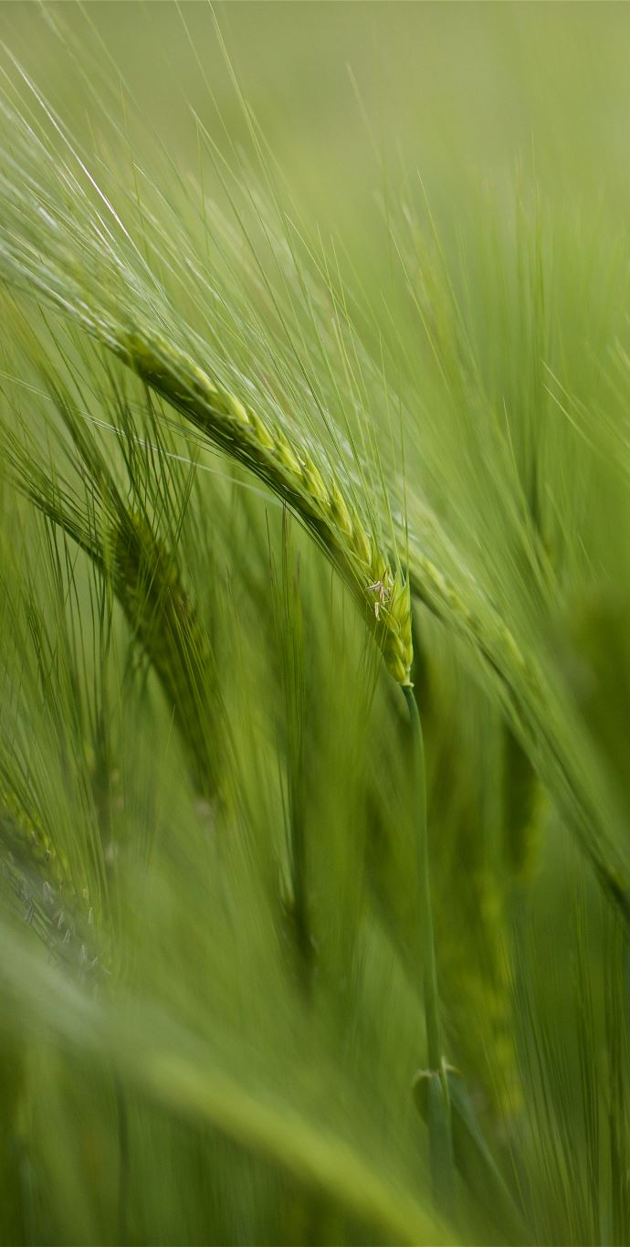
PROJECT OVERVIEW
Plant disease detection is a critical aspect of modern agriculture aimed at safeguarding crop health, maximizing yield, and ensuring food security. Detecting diseases in plants at an early stage is crucial to prevent widespread outbreaks, minimize economic losses for farmers, and reduce the need for extensive pesticide application. Several traditional and modern techniques are employed for plant disease detection, each with its advantages and limitations.
n conclusion, the integration of traditional knowledge with modern technologies such as molecular biology, remote sensing, and artificial intelligence is pivotal for enhancing plant disease detection capabilities and promoting efficient agricultural practices worldwide.

Slide 6
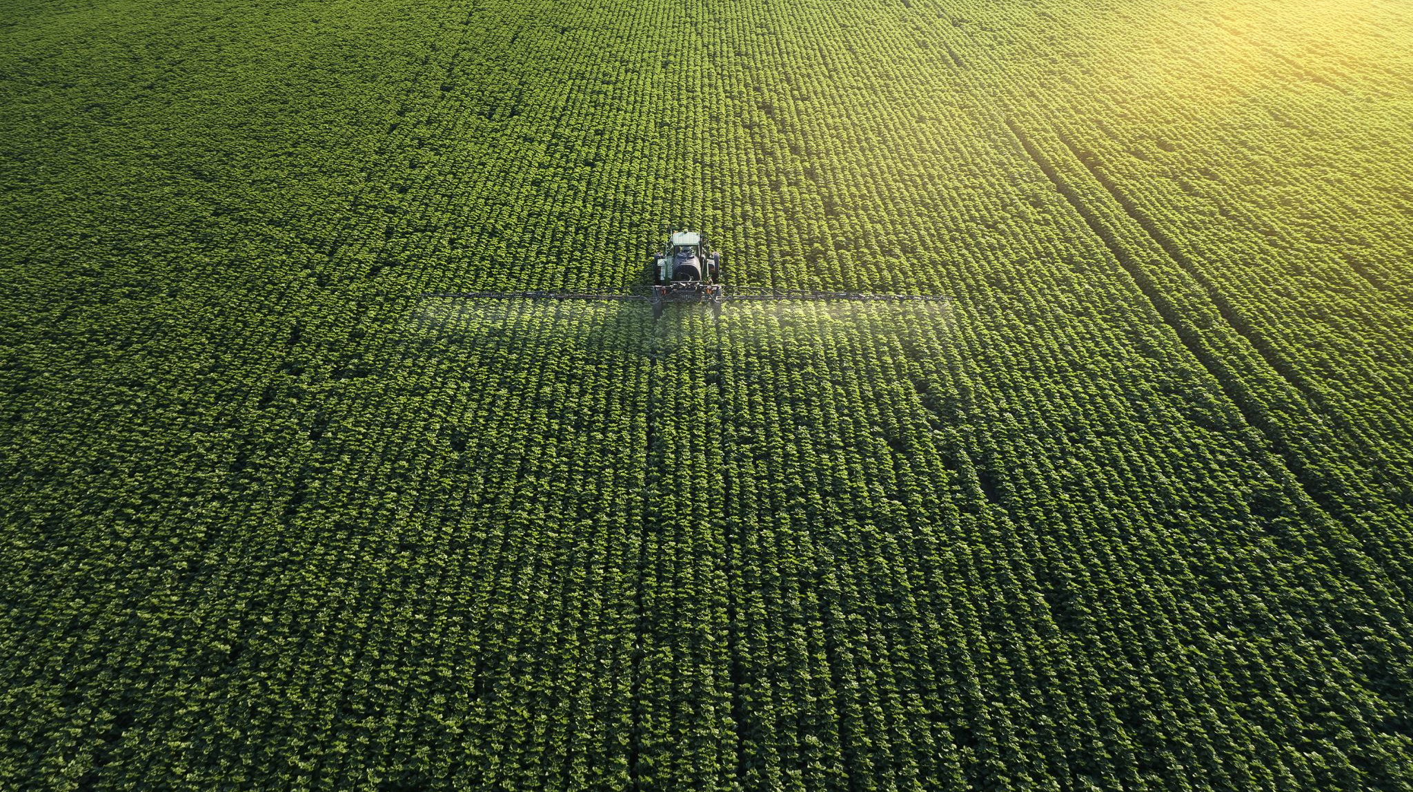
WHO ARE THE END USERS
Farmers: Small-scale and large-scale farmers who need to monitor and manage diseases in their crops to prevent yield losses and ensure crop health.
Agricultural Extension Services: Organizations or agencies that provide support and guidance to farmers may utilize disease detection technologies to offer timely advice and interventions.
Researchers and Scientists: Professionals in the agricultural and biological sciences who develop and improve disease detection methods, contributing to advancements in plant health management.
Agri-Tech Companies: Businesses that develop and market technologies and solutions for plant disease detection, providing tools and services to farmers and agricultural stakeholders.
Government Agencies: Departments or ministries responsible for agriculture and food security may use disease detection data for policy-making, resource allocation, and monitoring of disease prevalence at regional or national levels.

Slide 7
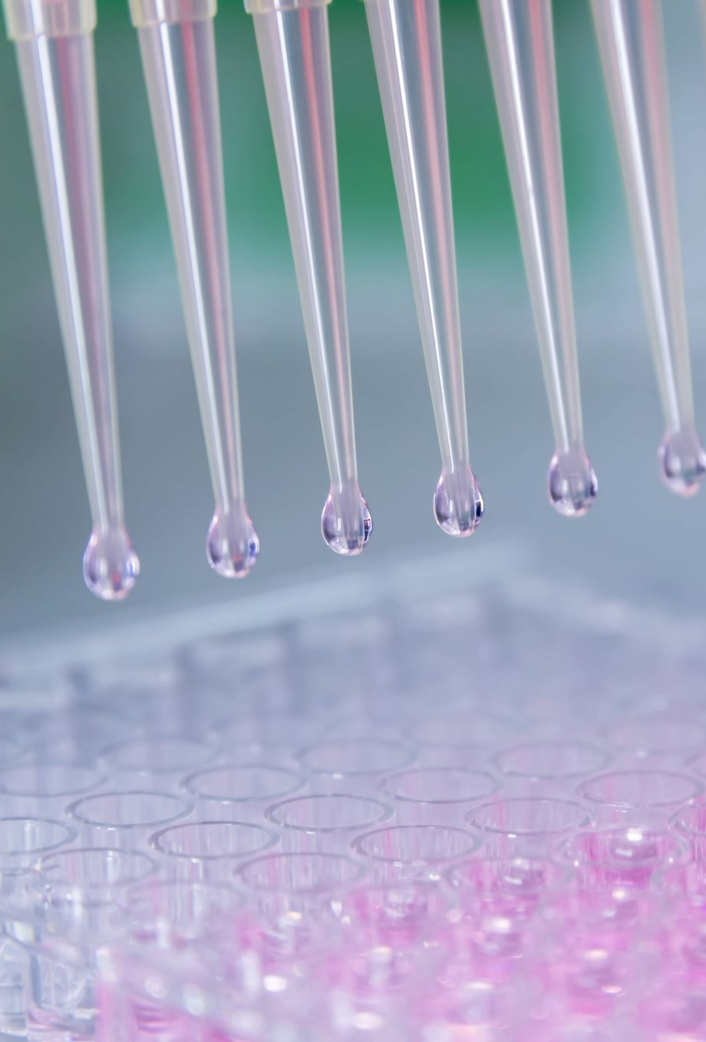
YOUR SOLUTION AND IT'S VALUE PROPOSITION
Our solution for plant disease detection leverages a combination of advanced technologies such as molecular biology, remote sensing, and artificial intelligence to provide accurate and timely detection of plant diseases.
Our solution for plant disease detection leverages a combination of advanced technologies such as molecular biology, remote sensing, and artificial intelligence to provide accurate and timely detection of plant diseases.

Slide 8

THE WOW IN MY SOLUTION
The "wow" factor in your solution for plant disease detection could be a unique feature or innovation that sets it apart from existing solutions and makes it particularly compelling.
incorporating one or more of these "wow" elements into your solution, you can not only improve the effectiveness of plant disease detection but also create a unique value proposition that resonates with farmers, agricultural organizations, and industry stakeholders.

Slide 9
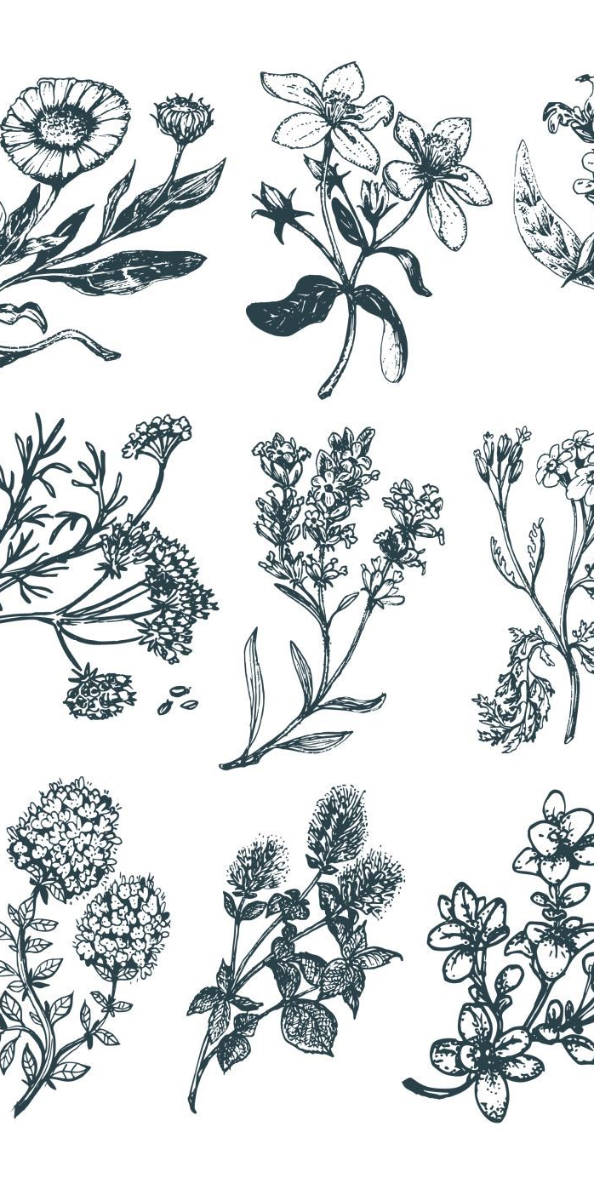
MODELLING
Data Collection: Gather a large dataset of images or sensor data representing healthy plants and plants affected by various diseases. Ensure that the dataset is diverse and includes different plant species, disease types, and stages of disease progression.
Data Preprocessing: Preprocess the data to prepare it for training. This may involve resizing images, normalizing pixel values, augmenting the data with transformations like rotation or flipping (for image data), and cleaning or filtering sensor data.
Feature Extraction (Optional): Depending on the complexity of your data and the modeling approach, you may need to extract relevant features from the raw data. For image data, this could involve using techniques like covveolutional neural networks (CNNs) for automatic feature extraction.
Model Selection: Choose a suitable machine learning or deep learning model for your task. Common choices for image-based tasks include CNN architectures such as ResNet, VGG, or custom-designed networks. For sensor data, you might use algorithms like decision trees, support vector machines (SVMs), or more advanced techniques like recurrent neural networks (RNNs) for time-series data.
Model Training: Split your data into training and validation sets (and optionally a test set). Train your chosen model on the training data using appropriate loss functions and optimization algorithms. Monitor the model's performance on the validation set to prevent overfitting.
Model Evaluation: Evaluate your trained model on the test set or a separate validation set to assess its performance metrics such as accuracy, precision, recall, F1 score, etc. Adjust hyperparameters and model architecture as needed to improve

Slide 10

RESULT
The result of plant disease detection using machine learning involves creating a model that can accurately classify whether a plant is healthy or diseased based on input data such as images or other relevant features. This model is trained using a dataset with labeled examples of healthy and diseased plants. The model's performance is evaluated using metrics such as accuracy, precision, recall, and F1 score. The ultimate goal is to develop a reliable and efficient system that can aid in early disease detection and help farmers make informed decisions about crop management.

